Slide 1

Graded Excel Assignment
OMKAR Dicholkar

Slide 2
Business Understanding
Nile is an e-commerce company which wants to improve their customer service based on their historical customer service data.
We need to identify patterns, trends & opportunities for improvement leading to customer loyalty & throughput

Slide 3
Data Understanding
It is segmented & clean data which needs to be trimmed & structured according to our analysis output required.
Used text to columns function for Date sorting and formatting.
Used find & replace function for Csat score ‘blanks’ with zeros.

Slide 4
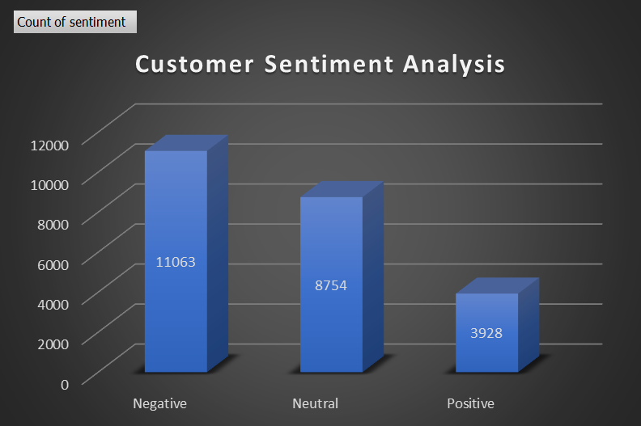
Customer Sentiment Analysis
There are higher number of negative sentiments than neutral or positive ones.
If we dive deep into that, then as per the comparison of Csat score & Response time, the negative sentiment is highest among people with Billing questions.

Slide 5
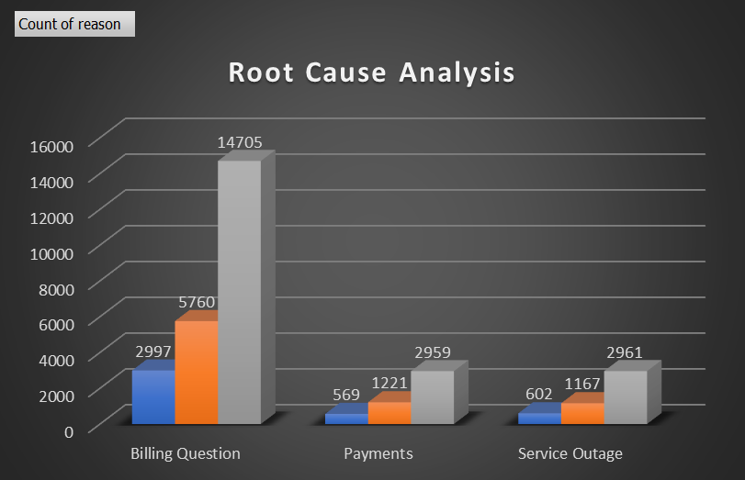
Root Cause Analysis
Common customer complaints is Billing related queries.
The channel through which the most payment queries are handled are Call centre so more workload is shared for Billing & Payment followups hence the increased response time.
Hence distribution of customer query through proper channel is something they can work upon

Slide 6
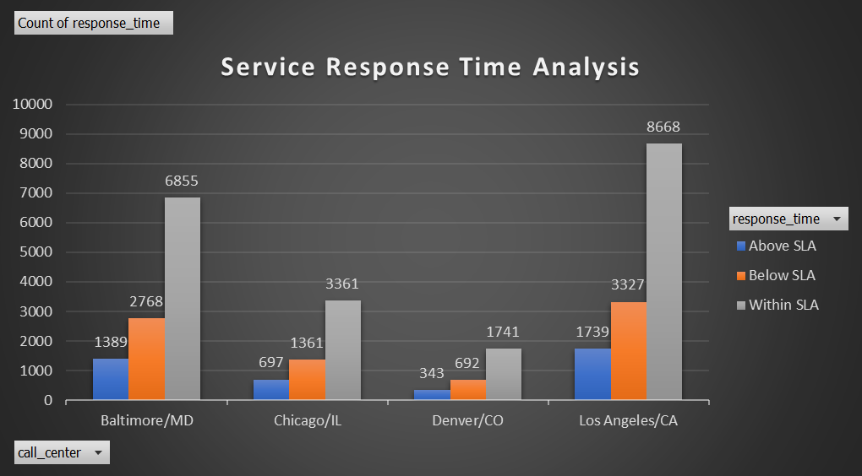
Service Response Time Analysis
LA team has response time within SLA which is highest amongst the dataset.
Denver has lowest score for resp. time below SLA.
So this builds up a picture that respective call centres will need to develop special case study wherein the efficiency of their service team can be improved & maintained in future.

Slide 7
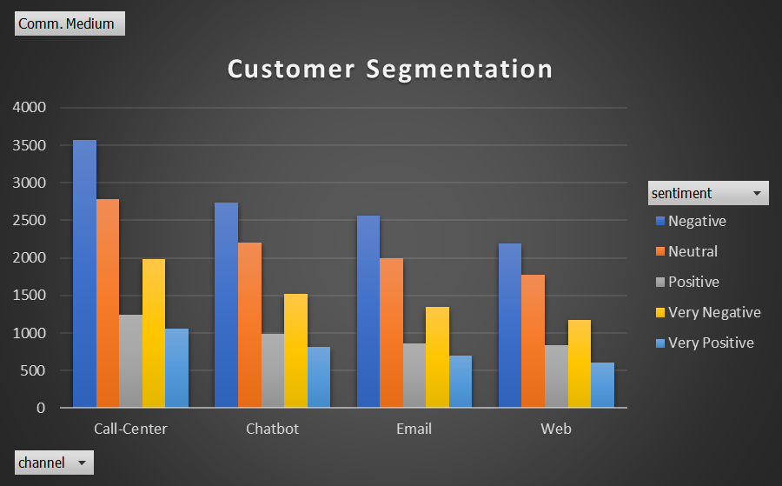
Customer Segmentation
Based upon the dataset presented, the customers have been pragmatic about their approach in identifying the fastest means of resolution for their query which is call-centre, wherein most positive & very positive inputs have been resolved through.

Slide 8
Trends & Patterns
To summarise, the trends & patterns within this dataset is something which I found to be of a research topic and honestly Nile needs to work upon their customer support services in a tech-savvy means such that their throughput can be improved & maintained.

Slide 9
THANK YOU

